Slide 1

Korean Restaurants in Los Angeles
An investigation for “Kor That’s Tasty”
Dougie Scott
10/01/2021

Slide 2
Background
Our client is an operator of a chain of Korean Restaurants.
They are not yet active in the USA, but are considering expansion. Los Angeles is their first city of choice.
They have requested an initial analysis of Los Angeles to identify suitable Districts, based on 3 criteria:
1. A good local population
2. Little/no competition from nearby Korean Restaurants
3. A good level of nearby non-Restaurant Amenities
The deliverable for our client will be the most suitable Districts, grouped into segments that provide them with shortlists for further investigation. Additionally, visualisations of the Los Angeles area are desired.

Slide 3
Data Acquisition
Los Angeles geography/demographics
A list of Los Angeles Districts, Zip Codes and Population counts from the 2010 census, obtained from the LA Almanac website. A total of 104 Districts in the Los Angeles area were considered.
The location data (Latitude and Longitude) for each Los Angeles Zip Code, obtained from Opendatasoft’s website.
Los Angeles venue information
From FourSquare, a full listing of venues in Los Angeles was found, each one related back to the specific District in which it resides. This venue data included Restaurants and other, Non-Restaurant Amenities. More than 1,500 individual Amenities were considered.

Slide 4
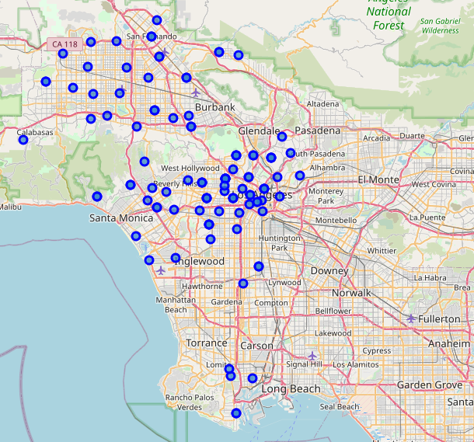
Los Angeles Neighbourhoods
Geographic model of Los Angeles, showing the Districts considered, and their locations in Los Angeles

Slide 5
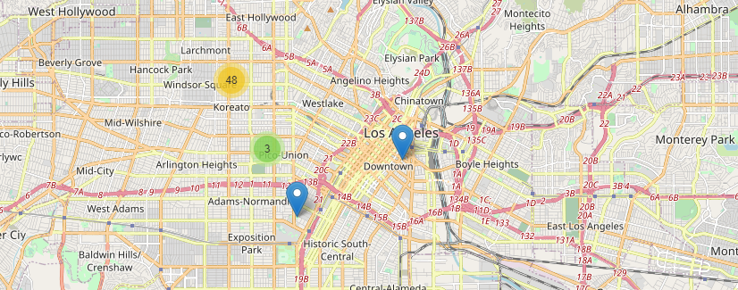
Los Angeles Korean Restaurants
Mapping of existing Korean Restaurants in Los Angeles, with counts of total Restaurants
Note how West-Central Los Angeles is overserved (48), yet other areas of the city are underserved

Slide 6
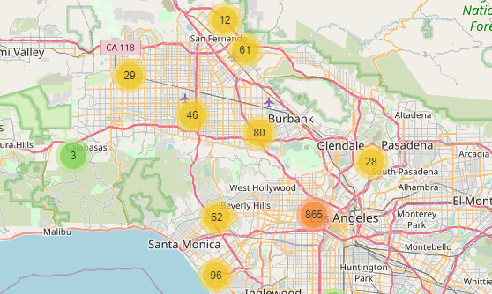
Los Angeles Non-Restaurant Amenities
Mapping of Non-Restaurant Amenities in Los Angeles, with counts of total Amenities
Central Los Angeles is dense with Amenities, although some outlying Districts show potential

Slide 7
District Scoring
A Desirability Score was computed for each District, in order to take account of the 3 variables of interest to our client
Population Density and Amenity Density are directly proportional to Desirability (more is good).
Korean Restaurant Density is inversely proportional to Desirability (more is bad)
Desirability = Population Density * Amenity Density * (1 / (1 + Korean Restaurant Density)

Slide 8
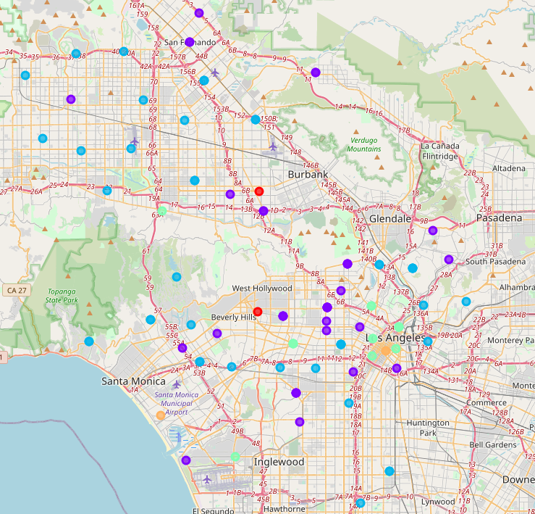
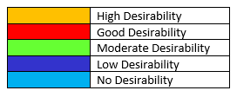
District Segmentation
K-means clustering used to provide our client with 5 segments of Districts, in order to focus on most desirable

Slide 9
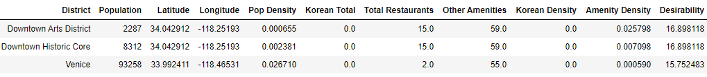
Which Districts?
Shortlist of most-desirable Districts
High Desirability
Good Desirability
The best Districts have a dense level of Amenities
The best Districts have a total absence of Korean Restaurants
Notice how there are already many Restaurants in these areas, suggesting potential and high footfall
Population is a lesser factor, but nonetheless important

Slide 10
Conclusion
We recommend our client prioritise these most Desirable Districts.
We counsel that our client should use their own domain expertise to further refine the choice. This investigation considers only some of the critical factors in determining Restaurant placement.

